Slide 1

Faculty of Islamic Sciences, Prince of Songkhla University: Virtual Visiting Professor Program
Wednesday 23-02-2022
By
Associate Professor Dr. Kamaruddin Abdulsomad
Lund University,
Sweden.

Slide 2
What Can We Learn from the Swedish Buytul Almal (The Swedish Model) to Improve the Management of Local Buytul Almal in the Four Southern-most Provinces of Thailand?
Statement of the Problem:
1- Many Islamic countries such as Malaysia and (Thailand) has been very successful in managing their Islamic finance for many decades without raising the standard of living of their population.
2- Malaysia and Thailand have been living with increasing poverty levels and low levels of Middle income traps (UN Report)

Slide 3
Problem
3. Islamic Economics Theory have not put into fully practices in many Islamic communities.
4. The moral issues of Islamic Economics have been lost.
5. Poverty and Inequality have been widespread in many Islamic communities despite high growth and opportunity.
6. Many local Muslim Institutions have lost their credibility in raising at a higher income level

Slide 4
Our discussion for this lecture
What is principle teaching, rules of behaviour and institutions in Islam?
What is a Swedish Model and how it management can be used to improve our local institutions to fucntion better?
3. Local institutions in the four southernmost provinces

Slide 5
Principle Teachings, Rules of Behaviour and Institutions in Islam
The Unity of Creation and Freedom of Choice
Human and Economic Development in Islam
Economic Structure and the Rules of Behaviour in Islam
The Islamic Vision of Distributive Justice
Islamic Finance
Institutions and their Importance in Islam

Slide 6
1. The Unity of Creation and Freedom of Choice
There are four fundamental concepts in the Islamic system
Walayahh = the unconditional, dynamic, active, ever-present Love of the Supreme of His Creation manifested through the act of creation and the provision of suffiecient resources to sustain life.
Humans reciprocate this love by extending their love other humans and to the rest of creation.
The persuit of walayahh is love manifested through knowledge and the upholding of justice.

Slide 7
1. The Unity of Creation and Freedom of Choice
2. The second is karamah = Human dignity.
The Quran considers humans to be the crowning achievement of the creation.
An important facet of this is the freedom that has been gifted to humans – to think, to decide and to choose their path in life, while supporting good and opposing evil.

Slide 8
1. The Unity of Creation and Freedom of Choice
3. The third is the meethaq = the primodial covenant in which all humans are called before their Supreme Creator and asked to testify that they recognize Him as the One and Only Creator and Sustainer of the entire Creation and all other implications flowing from this testimony.

Slide 9
1. The Unity of Creation and Freedom of Choice
4. The fourth concept is Khilafah = agency-trusteeship. Khilafah is the empowerment of humans by their Creator as agent – trustees to extend Walayahh to one another; materially through the resources provided to them by the Creator, and non-materially through unconditional love for their own kind as well as for the rest of creation, which can be best displayed by the pursuit of unity and justice.

Slide 10
1. The Unity of Creation and Freedom of Choice
A number of verses of the Quran affirm the unity of mankind [1:4; 13:49; 28: 31]
These verses plus those dealing with the availability of resources as well as human endownments are the foundation of the legislative framework of rules (Institutions) for the socio-economic-political behaviour of humans.

Slide 11
2. Human and Economic Development in Islam
The concept of development in Islam has three dimensions:
Individual self-development called rushd. The first specifies a dynamic process in the growth of the individual toward perfection.
The physical development of the earth called isti mar. The second specifies the utilization of natural resources to develop the earth to provide for the material needs of this individual and humanity.
The development of the human collectively, which includes both. The third concept refers to the belief that the Supreme Creator has provided the ways and the means to facilitate the achievement of all three dimensions of development.

Slide 12
2. Human and Economic Development in Islam
Scarcity is not the root cause of excessive inequality and distributional injustice, instead it is selfishness, the misuse of resources and human greed that cause scarcity, poverty, misery and destitution.
Self- development is necessary to transcend selfishness.
According to Islam, there are sufficient Resources if individuals share. The notion of sharing is central in Islam.

Slide 13
2. Human and Economic Development in Islam
When it comes to the development of the human collectivity, the Quran recognizes legitimate authorities, namely selected rulers
governments.
The important point here is that those in positions of authority must be rule-compliant if they are to oversee the implementation of the prescribed rule.

Slide 14
3. Economic Structure and the Rules of Behaviour in Islam
During his ten years in Medina, the Prophet developed numerous rules to guide economic and social behaviour: rules of governance, accountability and transparency, rules regarding property regarding property ownership and protection, rules regarding the formation and the structure of the market; rules concerning the role of the state in overseeing the market; rules of behaviour by market participants; rule regarding distribution and redistribution; rules related to education, technological progress and society’s infrastructure and rules regarding sources of government income and its expenditures.
The central exis of design and operation of these rules is justice.

Slide 15
4. The Islamic Vision of Distributive Justice
The concept of distríbutive justice the just division of the economic pie (production and wealth) among the members of society that includes owners of capital, workers, those that cannot provide for themselves and the animal species since many centuries is far from settled. Some see a role of for governments in its enforcement others do not.

Slide 16
4. The Islamic Vision of Distributive Justice
The Quran does not afford a separate or stand –alone theory of justice. Instead, the Quran indicate that compliance with rules of behaviour handed down in the Quran and interpreted by the Prophet assures the emergence of justice as a natural outcome of the practice of a rule compliant society.
Justice and a just political, social and economic system is thus an essential outcome of the Islamic system if Muslims comply with Divine rules.
Simply said, a society will be just in Islam if the rulers and the people are rule-compliant. Islam has two simple propositions for a just society (1) place things in their rightful position and (2) give everyone rightful due. The first can be merged into the second. The rightful place and right due are guaranteed by compliance with the rule.

Slide 17
4. The Islamic Vision of Distributive Justice
Given the rules governing property rights, work, production, exchange, markets, distribution and redistribution, it is reasonable to conclude that in a rule-complying and Allah-conscious society, absolute poverty could not exist.
The Prophet said that poverty is near disbelief and that poverty is worse than murder.
It is almost axiomatic that in any society in which there is poverty, Islam rules are not being observed. Thus rulers who live in opulence are prima facie not rule compliant, but those who do so while others live in poverty are also unjust and illegitimate.

Slide 18
5. Islamic Finance
The central proposition is risk sharing, which allows both parties to reduce the risk of income of volatility and to allow consumption smoothing, a major outcome of risk sharing.
More recently, a number of economists are again questioning the stability of conventional finance.

Slide 19
6. Institutions and their Importance in Islam
To lower transaction costs (North 1990) for high performing economies.
Transaction costs are an impediment to economic and social progress and prosperity.
They arise because getting access to information is costly and held asymmetrically by parties to an exchange.
It can be argued that tghe collectivity of institutions provides society with the social capability to establish a stable order by reducing uncertainties or ambiguities members of society face.

Slide 20
6. Institutions and their Importance in Islam
Islam requires institutions that monitor and enforce distribution and redistribution, that eradicate poverty and provided for those who cannot provide for themselves and who are still in need after individuals have done what is required of them, and insure a level playing field with equal access to high quality education and healthcare.

Slide 21
6. Institutions and their Importance in Islam
we must emphasize the capstone rule in Islam:
The rule commanding the good and forbidding evil
Applicable to individuals and society
Assures that leaders are selected by the community and are answerable for the actions
Leaders acquire legitimacy by being more rule-compliant than members of the community.
5. leaders must be confronted if they do not uphold Divine Rules and enforce them.
Income inequality absolute and relative poverty is evidence of rule-violation and governance failure.

Slide 22
Concluding Comments on the Islamic System
Allah could have created a world of total perfection inhabited by ”perfect” humans that had no free will.
If Allah has done so, human dignity would have been empty of any meaning.
Allah gave human freedom.
Islam is founded on freedom, equlity and justice.

Slide 23
Concluding Comments on Islamic System (Continue)
Thus the concept of justice in Islam is founded on freedom and equlity of humankind.
Allah gave humans bountiful resources that, if managed well and shared , could satisfy all human needs.
The Islamic economic system is a market based which is different from some capitalist economic theory.
Islam does not have a separate theory of justice.
Muslim countries need drastic institutional Reforms – social, economic and political – to realize their potential and reverse the centuries of missed opportunities.

Slide 24
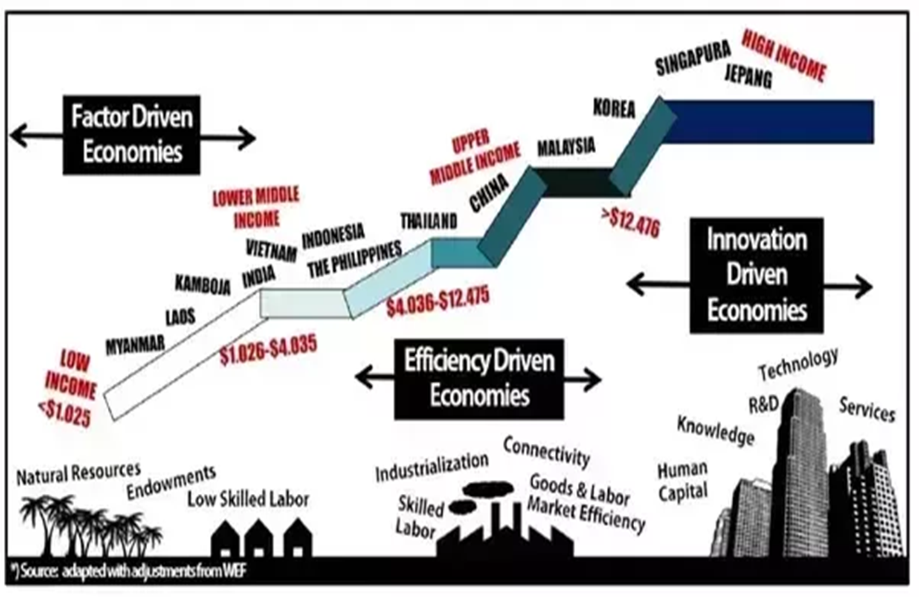
Long term Structural Transformation of the Economy

Slide 25
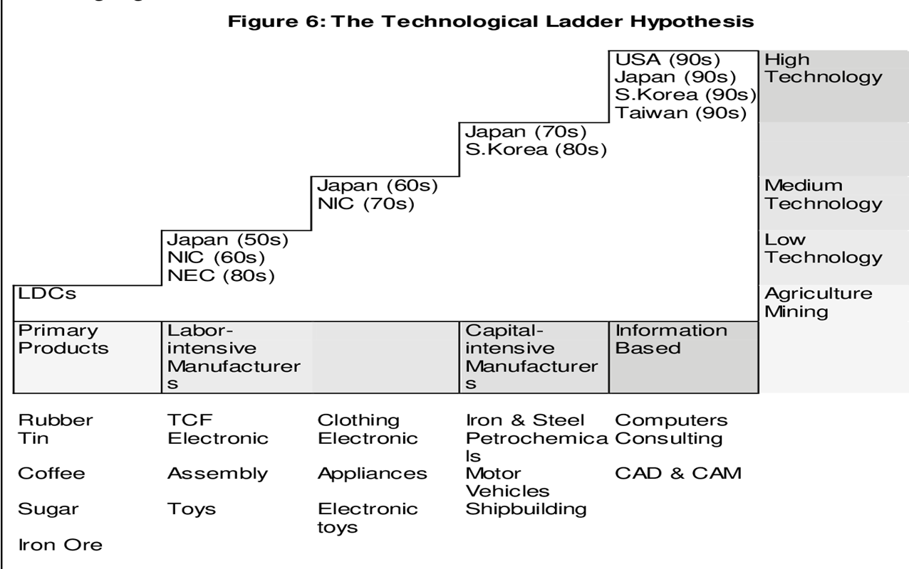
The Technological Ladder Hypothesis

Slide 26
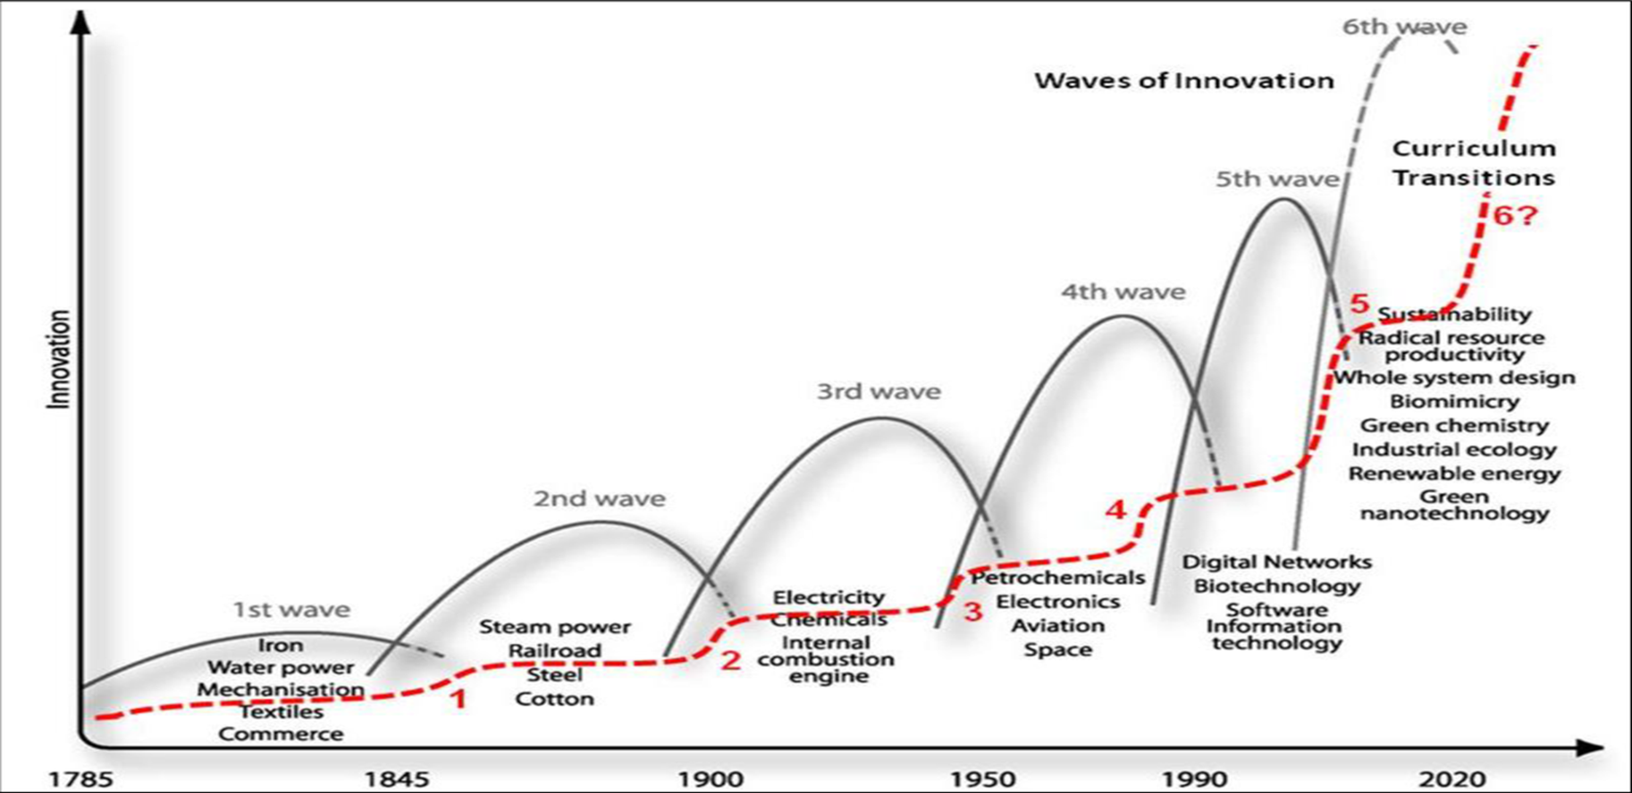
Techno-Economic Paradigm by Perez & Freeman

Slide 27
1. The Swedish Model
Sweden with 10 million population is a prosperous country whose wealth is evently distributed.
The Swedish model is a strategy for inclusive growth.
The Swedish Model can be said to consist of three fundamental pillars: a labour market, that facilitate adjustment to change, a universal welfare policy and an economic policy that promotes openness and stabilty.

Slide 28
The Swedish Model (continue)
Pillar 1:
A labour market that facilitates adjumstment to change:
Coordinated wage formation and readjustment support
Active labour market policy
Effective unemployment inscurance
Prerequisites
Sound public finances
Trust, legitimacy
High employment
Strong and equal social partners
Pillar 2:
Welfare policy:
Universal welfare services
Universal social transfers that promote work and income security
Pillar 3:
Economic policy:
Openness and stability

Slide 29
2. The main objectives of the Swedish Model
2.1 Prosperity, equity and gender equality
1. The Swedish Model is to ensure that prosperity increases and is eqitably distributed among citizens.
2. High and rising prosperity is dependent upon a dynamic business sector that contributes to high productivity growth and employment.
3. The equity goal is based on the fundamental belief in the equal value of all human beings and their equal rights to independent and autonomous live

Slide 30
2. The main objectives of the Swedish Model
4. Unemployment is the most common cause of economic disadvantage and lack of work also entails exclusion from many social contexts.
5. The effort to achieve equitable distribution of income thus begins in the labour market, where the education policy and the active labour market policy, along with coordinated wage formation, are intended to create the conditions for high and equally distributed real wages.
This requires policy to be designed so that everyone is provided good opportunities for education and work, regardless of social background. The redistribution policy has impact through taxation and transfer systems that further equalise disposible incomes.
6. Need-based provision of publicly financed servises, such as schools, elderly care and healthcare also contributes to more equitable distribution of total resouces.

Slide 31
2.2 Autonomy and independence
One of the goals of the Swedish model is to safeguard citizens autonomy and independence and prevent power imbalance (employees and employers)
The Swedish model minimises the immediate ties of dependency on family, neighbors, employers and civil society organizations.

Slide 32
3. The relationship between Efficiency and Equity
The large public sector debate in Economics
Okun (1975) the big trade-off
Andersen SOU (2015) moral hazards in policy design. A good balance between rights conditional upon duties
Lindbeck (2008) and Ljunge (2011), time and system designed
Andersen and Maibom (2016) economic performance and resources are used effieciently if institutions are well-designed and the state of technolological progress. Well designed policy and good institutions.

Slide 33
3. The relationship between Efficiency and Equity
Sweden, Denmark, Norway and Finland have managed well in terms of efficiency and equality.

Slide 34
3.1 The relationship between welfare policy and the long-term GDP level
Empirical research has found evidence of a correlation between the type of expenditure and tax and economic performance.
Productive expenditures are associated with better economic performance if financed by the least distortionary modes of taxation.
Productive expenditures are such that have a direct impact on employment and income (spending on education and childcare).

Slide 35
3.2 Welfare ” from the cradle to the grave”
Another central aspect of the Swedish model is that the publicly provided welfare services and the social security systems cover an individual’s entire life course from the cradel to the grave.
Children and youths are the beneficiarise of children and education, older people of long-term care services and pensions, while the working-age population are contributors through income taxes.
All age groups are beneficiaries of healthcare and transfers, but to various extents.
Economies with stronger social contracts across generations have relatively larger public sectors but because the public sector partially overcomes market failures and results in higher investments in welfare in general and education in particular, it also generates higher prosperity (output).

Slide 36
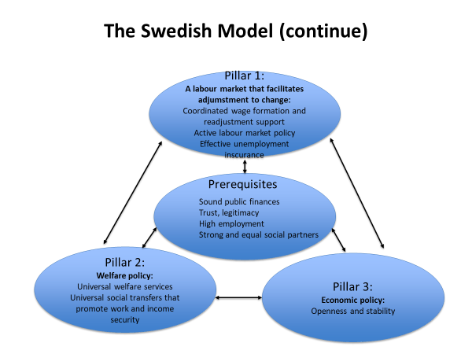
4. The model’s pillars and prerequisites

Slide 37
3. Local Institutions
How Buytul Al-Mal has been practiced at local institution level?
Majlis Agama Islam at provincial level
Masjid
Or Bor Tor
Thesaban

Slide 38
Islamicity Indices and their Elements Economic Islamicity Index
Economic Opportunity and Economic Freedom
1.1 Business Environment
1.2 Economic Regulation Indicator
1.3 Ease of Doing Business Indicator
1.4 Economic Freedom Indicator
1.5 Business and Market Freedom Indicator

Slide 39
2 Job creation and Equal Access to Employment 3. Property Rights and Sanctity of Contracts
2.1 Equal Employment and Job Creation
2.2 Labour Freedom
3.1 Property and Contract Rights

Slide 40
4. Provisions to Eradicate Poverty, Provision of Aid and Welfare
4.1 Poverty Effectiveness Indicator
4.2 World Given index
4.2.1 Helping a stranger
4.2.2 Donating money
4.2.3 Volunteering time
4.3 Social Welfare

Slide 41
5. Supportive Financial System
5.1 Investment Freedom
5.2 Financial Freedom
5.3 Moneytary Freedom
5.4 Financial Market Risk Indicator

Slide 42
6. Adherence in Islamic Finance
6.1 Absence of Interest indicator
6.1.1 Central Bank discount rate
6.1.2 Commercial Bank prime lending rate

Slide 43
7. Economic Prosperity
7.1 Economic Prosperity
7.2 Price Stability
7.3 GDP per capita
7.4 GDP Per Capita Average Growth Rate
8. Economic Justice
8.1 Income Distribution

Slide 44
II. Legal and Governance Islamicity Index
9. Legal Integrity
9.1 Legal and Judicial Integrity Indicator
9.1.1 Judicial independence
9.1.2 Impartial courts
9.1.3 Integrity of the legal system
9.1.4 Protection of property rights
9.1.5 Legal enforcement of contracts
9.1.6 Regulatory restrictions on the sale of real property
9.1.7 Business cost of crime

Slide 45
9.2 Military Interference Indicator
9.2.1 Military interference in the rule of law and the political process index.
9.2.2 Reliability of police
10 Prevention of Corruption
10.1 Transparency International Indicator
10.2 Freedom from Corruption Indicator
11. Safety and Security Index
11.1 Safety and Security Index

Slide 46
12. The Management Index
12.1 Government Management
12.1.1 Level of difficulty
12.1.2 Management performance
12.1.3 Steering capability
12.1.4 Resource efficiency
12.1.5 Consensus building
12.1.6 International cooperation

Slide 47
12.2 Management of Depletable and other Natural Resources
12.2.1 Protection of animal rights
12.2.2 Environmental health
12.2.3 Air quality
12.2.4 Water resources
12.2.5 Productive natural resources
12.2.6 Biodiversity and habitat
12.2.7 Sustainable energy

Slide 48
13. Government Governance
13.1 Voice and Accountability Indicator
13.2 Political Stability and Absence of Violence Indicator
13.3 Government Effectiveness Indicator
13.4 Regulatory Quality Indicator
13.5 Rule of Law indicator
13.6 Control of Corruption Indicator

Slide 49
III. Human and Political Rights Islamicity Index
14. Human Development
14.1 Human development index
15. Social Capital
15.1 Social Capital Indicator
16. Personal Freedom
16.1 Personal Freedom Index
17. Civil and Political Rights
17.1 Civil Liberty Indicator
17.2 Political Rights indicator

Slide 50
18. Women’s Rights
18.1 Gender Inequality
18.2 Proportion of Seats Held by Women in the National Parliament
18.3 Ratio of women to men
19. Access to Education
19.1 Education Indicator
19.2 Education Prosperity
19.3 Education Equality Indicator
19.4 Education Effectiveness

Slide 51
20. Access to Healthcare
20.1 Life Exoectancy at Birth
20.1 Health Quality
20.2 Health prosperity
20.4 Mortality Rate
21. Democracy
21.1 Global Democracy index

Slide 52
IV. International Relations Islamicity Index
22. Globalisation index
22.1 Economic Globalization Indicator
22.1.1 Globalization Index
22.1.2 Restrictions
22.2 Social Glabalization Indicator
22.2.1 Personal Contact
22.2.3 Cultural proximity
22.2.4 Freedom of foreigner to visit
22.3 Political Globalization Indicator
23. Military Wars
23.1 Militarization Index

Slide 53

THANK YOU

