Slide 1

Why do you need to learn how to write a research paper?
In college, you will be asked to write many research papers, and you need to learn what goes into writing a successful paper.
This presentation will give you step-by-step directions on how most high school and college teachers/professors expect you to write a basic research paper.
Learning Targets:
How to choose a topic?
How to write a thesis or introductory statement?
Understand the difference bet. plagiarism and acceptable plagiarism
Learn how to use “parenthetical notations.”
Bibliography & proper format.

Slide 2

“sercher”
- to seek or search
from an old French word,
Research
prefix “re”- again
It is defined as “intensive search with the purpose of becoming certain”.
It is a systematic investigation into reality to gain knowledge.

Slide 3


#structure
Grab a copy on

Slide 4


#structure
of a research paper
Abstract
Introduction/ thesis statement
Literature Review
Methodology
Results
Discussion
Conclusion
Reference
Appendices
Main parts of a composition:
Introduction
Body
Conclusion

Slide 5

Structure of the Research Paper
Section |  | Purpose of the Section
Abstract |  | To briefly introduce the reader to the aims of the study, the methodology, results and findings.
Introduction and/or thesis statement |  | To state a clear overall purpose for the study, often framed in a discussion of the need the research is satisfying. To define the research question(s) of the study. To give a very brief background of relevant theory and practice for your topic.
Literature Review |  | To summarize what conclusions have been reached in the research literature and whether different writers agree or not. To highlight main issue and controversies around the problem.

Slide 6

Structure of the Research Paper
Section |  | Purpose of the Section
Methodology |  | To demonstrate that you are aware of the research methods used to study this topic. To explain and justify the method of data collection and analysis.
Results |  | To present the findings of your research in an orderly manner, using heading planned in your methodology or headings arising from patterns found in the research.
Discussion |  | To comment on the trends/findings and show your understanding of what your data suggests. To highlight anything unexpected that came up.

Slide 7

Structure of the Research Paper
Section | Purpose of the Section
Conclusion | To sum up your findings and highlight the significance of the outcomes of your study. To discuss the limitations of your study and indicate where further research is needed.
Reference | To list alphabetically all the reference materials that have been cited in the text of the report.
Appendices | To present relevant details such as letters to participants and organizations. To present details of questionnaires, surveys and other relevant instrument that you developed for the purpose of the study. To present relevant documents, e.g. Reports/policy/ historical documents.

Slide 8

#how to write?
Grab a copy on

Slide 9


Abstract
It is a summary of a body of information; it expresses the main claim and argument of a paper.
#how to write?
Questions that an abstract answers:
Why did you do this study or project?
What did you do and how?
What did you find?
What do your findings mean?

Slide 10


Introduction
The primary purpose of an introduction is to frame the paper for its readers. It should provide:
brief description of the topic
statement as to why the topic is worth researching or why it could be found interesting
statement of the research objectives.
statement of the method(s) and the
scope of study.
An overview of the rest of the paper.
#how to write?

Slide 11

Literature review
Four guide questions:
What is the present state of knowledge regarding the topic under consideration?
How are the studies related to the one being proposed?
What is the quality of the studies reviewed?
How will the proposed study contribute to the existing literature?
#how to write?

Slide 12

Methodology
To demonstrate that you are aware of the research methods used to study this topic.
To justify the research method and approach you have taken or your study.
To explain and justify the method of data collection and analysis.
#how to write?

Slide 13


Conclusion
The ‘results’ and ‘discussion’ should be the focus of this part.
To sum up your findings and highlight the significance of the outcomes of your study.
To outline any implication or recommendations indicated by the findings.
#how to write?

Slide 14

Conclusion
Results - to present the findings of your research in an orderly manner, using heading planned in your methodology or headings arising from patterns found in the research.
Discussion - show your understanding of what your data suggests.
#how to write?

Slide 15

Reference(s)
To list alphabetically all the reference materials that have been cited in the text of the report.
Referencing your paper
References need to contain all works cited in the text.
References should consistently follow one recognizable system.
#how to write?

Slide 16


Appendices
To present relevant details such as letters to participants and organizations.
To present details of questionnaires, surveys and other relevant instrument that you developed for the purpose of the study.
To present relevant documents,
e.g. Reports/policy/ historical documents.
#how to write?

Slide 17

#where & how do we begin?
Grab a copy on

Slide 18
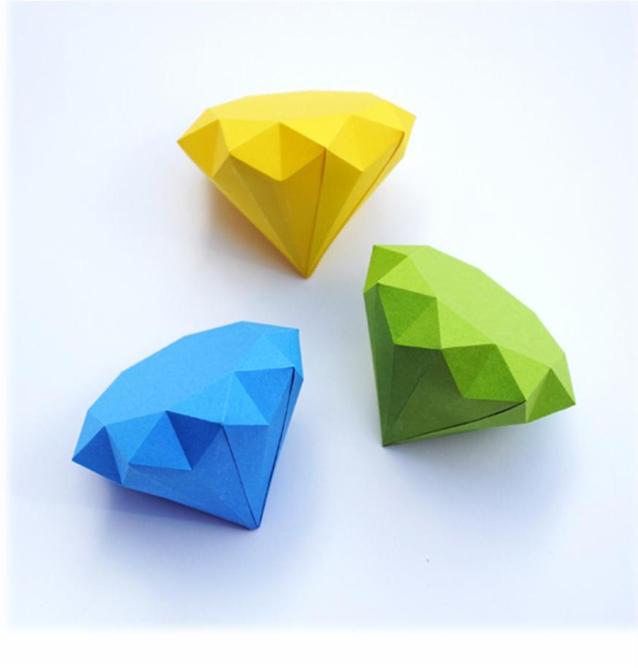
Choose a subject
that interests you but from which you can still learn much
not too broad
not too difficult, one for which you can find materials from popular magazines or books aimed at general reading.
that has some interest for the average reader.
Choosing_{a} Subject for Research Paper

Slide 19



Observation or experience
Interview
The library
Special bulletins and reports
G
athering of
Materials

Slide 20
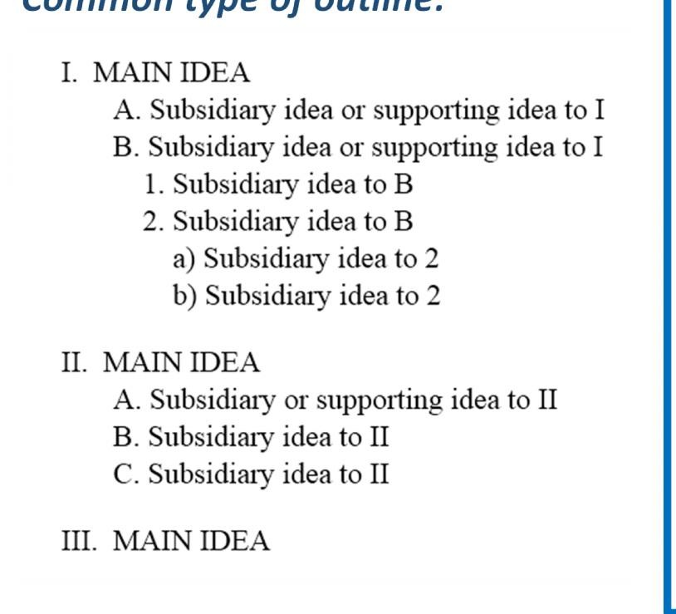
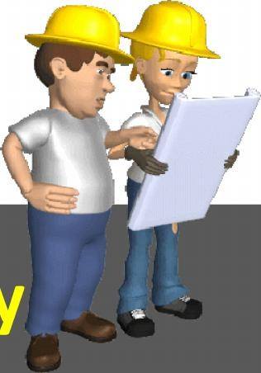
Common type of outline:
Have some ideas of topics in which you will be needing information.
Begin your reading with a few general articles which give an overall survey.
Try to anticipate the important questions your paper will have to answer.
Jot down what seems to be the major divisions of the subject.
Make a Preliminary Outline

Slide 21

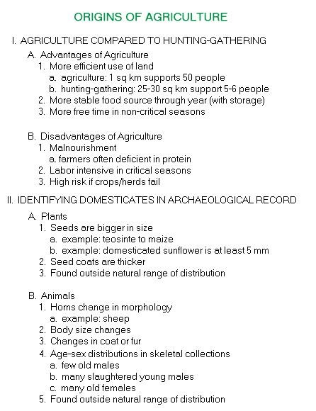
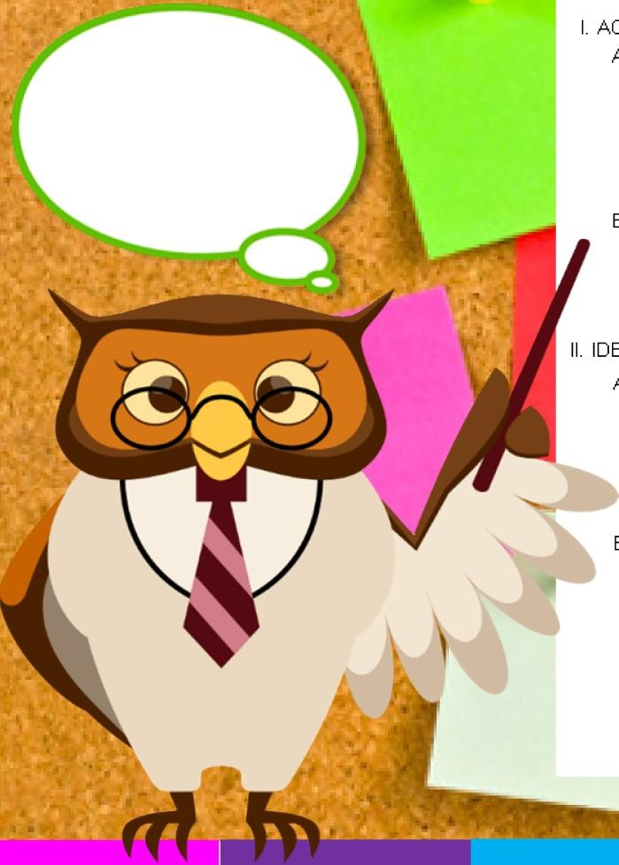


Slide 22
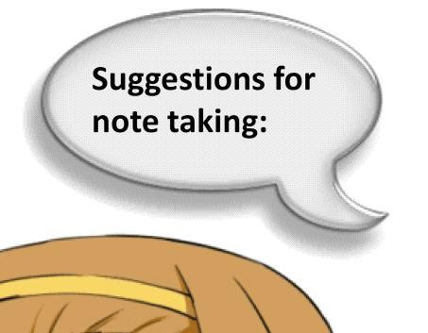

Use unrolled index, preferably 4x6 inches in size.
Cover only one subject on each card.
Write the subject on the left hand corner.
Name the exact source.
Use direct quotations if you want to include your paper the author’s exact wording.
Make most of your notes brief statement in your own words.
Suggestions for note taking:
Note taking

Slide 23





Quoting means to REPEAT
another source
word for word, using quotation
marks.
Parenthetical
Citations

Slide 24
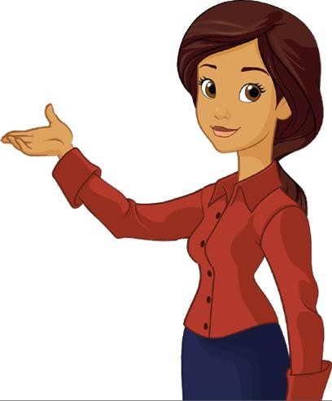

Keys to Parenthetical Citations
Keep quotes short
Give only information needed to identify the source on your Works Cited Page
You don’t need to cite information that is “common knowledge”
“Make it easier for your reader!”
❑ Keep quotes short
❑ Give only information needed to identify the source on your Works Cited Page
❑ You don’t need to cite information that is “common knowledge”
Parenthetical
Citations

Slide 25

To show that an authority supports your point;
To present a position or argument;
To include especially moving or historically significant language; and
To present a particularly well-stated passage whose meaning would be lost or changed if paraphrased or summarized.
In research papers, you should quote from a source:
“How do I
QUOTE
an author?”
“How do I
QUOTE
an author?”
W
hen to QUOTE
an author?

Slide 26

PLAGIARISM
Passing of someone else’s work as your own, whether we do this deliberately or not.
Not acknowledging when using information (i.e. data, tables, figures or graphics) from other writers.
Inadequately paraphrasing a source.
1. Passing of someone else’s
work as your own, whether we do this deliberately or not.
2. Not acknowledging when
using information (i.e. data, tables, figures or graphics) from other writers.
3. Inadequately paraphrasing a source.
_{A} D_{s}o_{o}c_{u}u_{r}m_{c}e_{e}nting

Slide 27
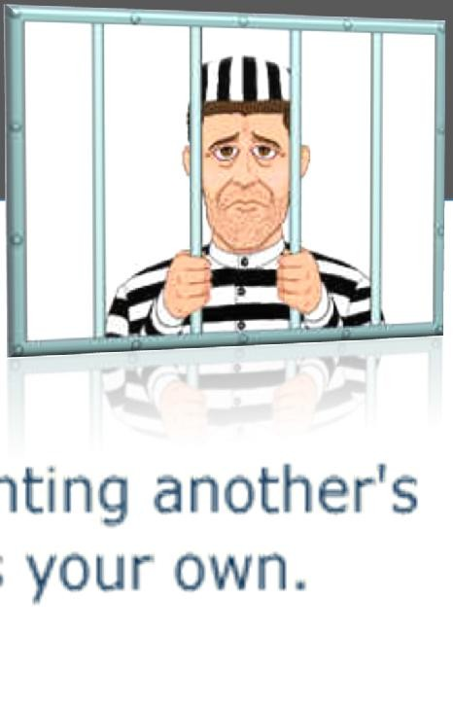




Paraphrase!!!
I’ve just stolen other author’s work!
PLAGIARIZER

Slide 28


Plagiarism v. Paraphrasing
Direct quote from research: Non-plagiarized paraphrase:
“Japan’s beautiful Mount Fuji last erupted in 1707 and is now classified as dormant. Dormant volcanoes show no signs of activity, but they may erupt in the future.”
Mount Fuji, the highest mountain in Japan, is actually a dormant volcano. Dormant means that it is not active. The last time Mount Fuji erupted was in 1707, and there is always the possibility of a future eruption.

Slide 29


Plagiarism v. Paraphrasing
Direct quote from research:
“Three weeks after Katrina, warnings of the arrival of Hurricane Rita sent residents of cities such as Houston, Texas, rushing to evacuate, fearing for their lives. Fortunately, Hurricane Rita turned out to be much less severe than Katrina. However, mass evacuations like this bring hazards of their own, as panicking drivers may cause accidents on the jammed roads.”
Non-plagiarized paraphrase:
Shortly after Hurricane Katrina devastated the city of Houston, Texas, a warning for a new hurricane named Rita was broadcast, which caused many people to panic and flee the city. However, the mass departure of people leaving Houston at the same time could have caused many car accidents, even though the hurricane turned out to be not as dangerous as Katrina.

Slide 30

#why use a consistent format?
Grab a copy on

Slide 31
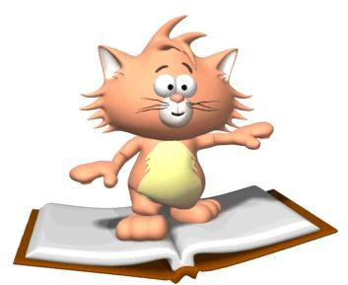


Why use a
Consistent Format?
Helps your reader understand your arguments and the sources they’re built on.
Allow readers to cross-reference your sources easily I they are doing further research.
Provides consistent format.
Gives you credibility and reliability as a writer.

Slide 32


Why should you bother?
It demonstrates you have looked up the information to prove your points.
Colleges require a specific format.

Slide 33

#formatting your research
Grab a copy on

Slide 34

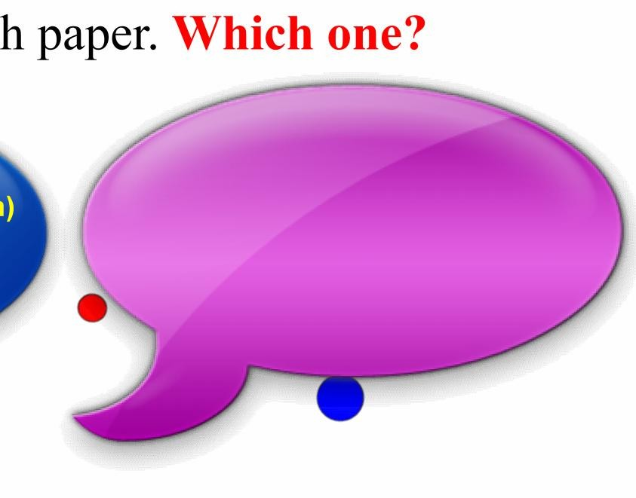
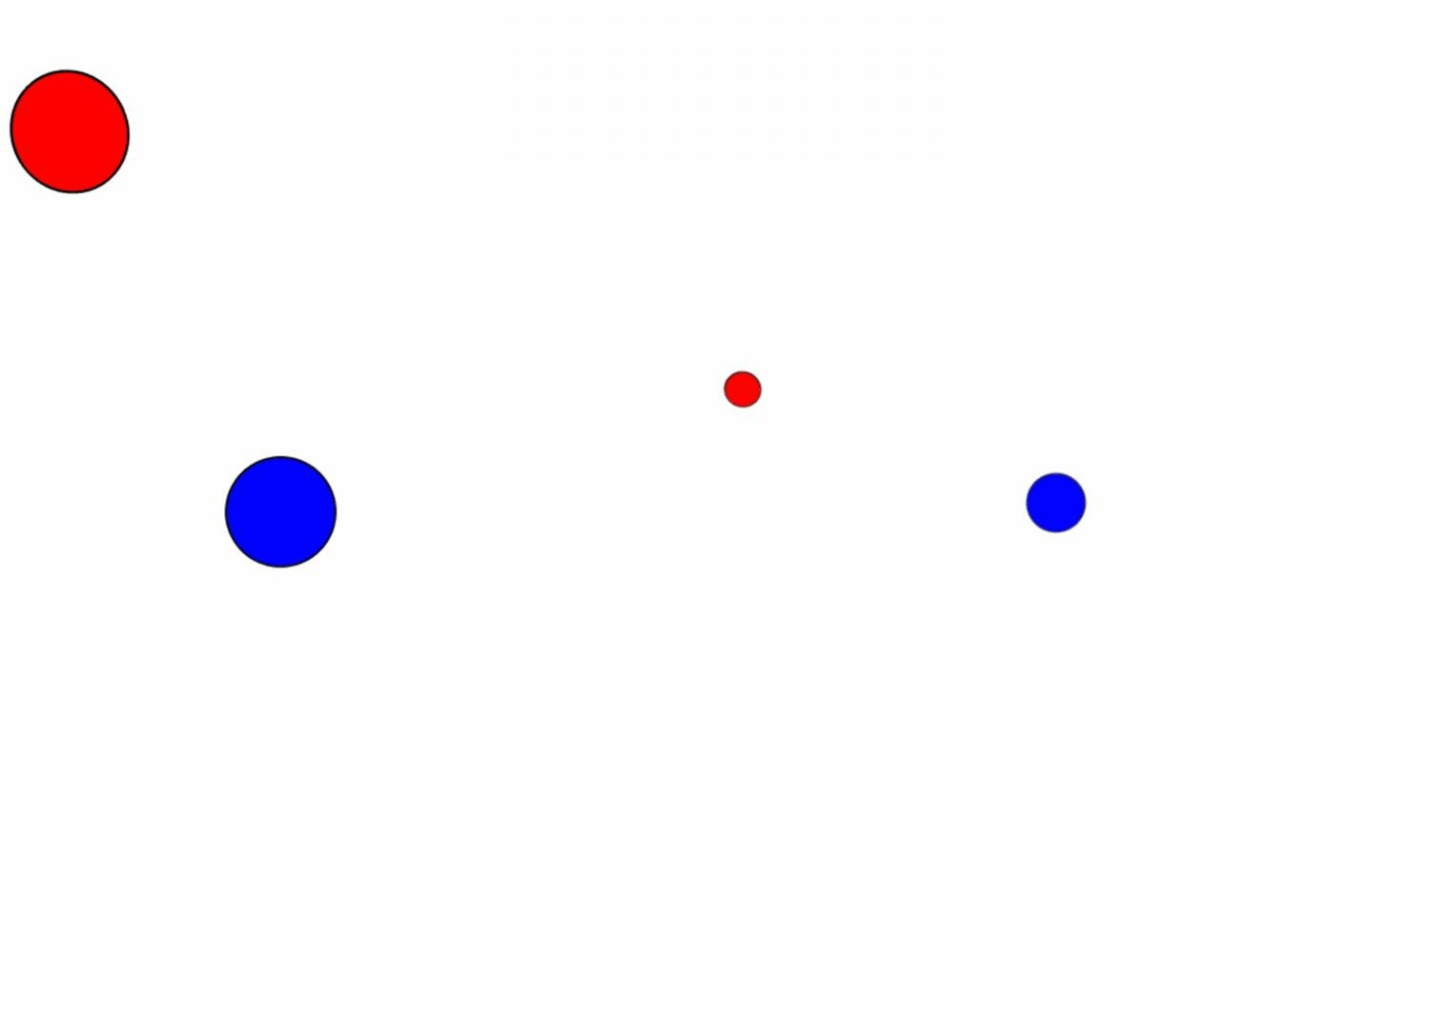

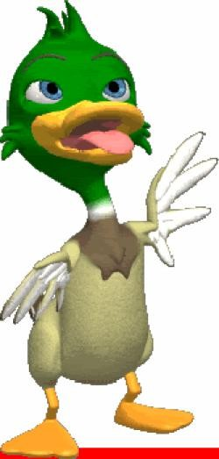

Formatting your researc
h paper. Which one?
n)
APA Format
MLA Format
(Modern Language Associatio
- is the official guide to non-fiction writing widely adopted by schools, academic departments, and
(American Psychological Association)
- is an academic format commonly used to cite sources within the social sciences.
Used by various other scientific journals (including medical and public health journals), textbooks, and
mia.
instructors _{acade}
ACM Format
(Association for Computer Machinery)
is the largest and oldest
international scientific and industrial computer society where they publish their own journals or proceedings.

Slide 35
 | MLA Guidelines |  | APA Guidelines
Paper | Standard size (8.5 x 11" in the U.S.)
Page Margins | 1" on all sides (top, bottom, left, right) |  | 1" on all sides (top, bottom, left, right)
Font | 12-pt. easily readable (e.g., Times Roman) |  | 12-pt. Times Roman or Courier. For figures, however, use a sans serif font such as Arial.
Spacing | Double-spaced throughout, including captions and bibliography |  | Double-spaced
Alignment of Text | Flush left (with an uneven right margin) |  | Flush left (with an uneven right margin)
Paragraph Indentation | 1/2" (or five spaces) |  | 5–7 spaces
End of Sentence | Leave one space after a period unless your teacher prefers two. |  | Leave one space after a period unless your teacher prefers two.
Page Numbers | On every page, in the upper right margin, 1/2" from the top and flush with the right margin put your last name followed by the page number. |  | On every page (except Figures), in the upper right margin, 1/2" from the top and flush with the right margin, two or three words of the paper title (this is called the running head) appear five spaces to the left of the page number, beginning with the title page.

Slide 36

 | MLA Guidelines | APA Guidelines
Title Page | Only if your teacher requests one. Instead, on the first page, upper left corner place on separate lines, double-spaced: Your name Teacher's name Course name or number Date Underneath, center the title using regular title capitalization rules and no underline. Start the report immediately below the title. | The title page is always the first page. On the line below the page number, the running head is typed flush left (all uppercase) following the words "Running head:" Below the running head, the following are centered on their own lines, using upper and lower case: Paper title Your name Your school
Section Headings |  | Top level headings should be centered on the page, using upper and lower case. Second level headings should be flush left, italicized, using upper and lower case.

Slide 37
 | MLA Guidelines | APA Guidelines
Tables & Illustrations | Place tables and illustrations as close as possible to the text they refer to. A table is labeled Table and given a number (e.g., Table 1). The table label and caption or title appear above the table, capitalized like a title, flush left. Sources and notes appear below the table, flush left. Photos, graphs, charts or diagrams should be labeled Figure (usually abbreviate Fig.), and assigned a number (e.g., Fig. 1). The label, title, and source (if any) appear underneath the figure, flush left, in a continuous block of text rather than one element per line. | Unless your teacher tells you otherwise, tables and illustrations appear at the end of the paper. Each table begins on a separate page with the label Table 1 (etc.) typed flush left on the first line below the page number. Double- space and type the table title flush left (italicized using uppercase and lowercase letters). Figures Captions appear on the last numbered page of the paper. In this case the label Figure 1 (etc.) is italicized and the caption itself is not. The caption uses regular sentence capitalization. The figures themselves follow, one per page.

Slide 38
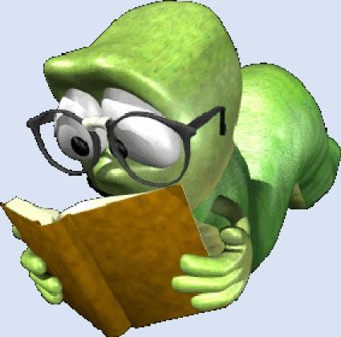
 | MLA Guidelines | APA Guidelines
Order of Major Sections |  | Each of these sections (if present) begins on a new page: Title page Abstract Body References Appendixes Footnotes Tables Figure Captions Figures
Binding | Most teachers prefer a simple paper clip or staple. Follow your teacher's request.
Additional Information | Purdue University Online Writing Lab (OWL) - MLA Style Guide | Purdue University Online Writing Lab (OWL) - APA Style Guide

Slide 39

#writing bibliography
Grab a copy on

Slide 40


Bibliography is a list of the sources you used to get information for your report.
As a rule of academic writing, students need to admit the truth when they use other people's ideas, views, data, information, written materials, audiovisual resources, etc. When you use a direct quotation or copied section, follow cite the source and no bibliography truth secret. It intends to tell reader about accuracy, value and relevancy of the sources that are cited.
As a rule of academic writing,
students need to admit the truth when they use other people's ideas, views, data, information, written materials, audiovisual resources, etc. When you use a direct quotation or copied section, follow cite the source and no bibliography truth secret. It intends to tell reader about accuracy, value and relevancy of the sources that are cited.

Slide 41
 | MLA Format |  |  | APA Format
 | BOOKS
 | Author's last name, first name. Book title. Additional information. City of publication: Publishing company, publication date. |  |  | Author's last name, first initial. (Publication date). Book title. Additional information. City of publication: Publishing company.
 | Allen, Thomas B. Vanishing Wildlife of North America. Washington, D.C.: National Geographic Society, 1974. Searles, Baird, and Martin Last. A Reader's Guide to Science Fiction. New York: Facts on File, Inc., 1979. Toomer, Jean. Cane. Ed. Darwin T. Turner. New York: Norton, 1988. |  |  | Allen, T. (1974). Vanishing wildlife of North America. Washington, D.C.: National Geographic Society. Searles, B., & Last, M. (1979). A reader's guide to science fiction. New York: Facts on File, Inc. Toomer, J. (1988). Cane. Ed. Darwin T. Turner. New York: Norton.

Slide 42
MLA Format APA Format ENCYCLOPEDIA AND DICTIONARY
Author's last name, first initial. (Date). Title of Article. Title of Encyclopedia (Volume, pages). City of publication: Publishing company.
Tobias, R. (1991). Thurber, James. Encyclopedia americana. (p. 600). New York: Scholastic Library Publishing.
Pettingill, O. S., Jr. (1980). Falcon and Falconry. World book encyclopedia. (pp. 150-155).
Chicago: World Book.
Author's last name, first name. "Title of Article." Title of Encyclopedia.
Date.
Tobias, Richard. "Thurber, James."
Encyclopedia Americana. 1991 ed.
Pettingill, Olin Sewall, Jr. "Falcon and Falconry." World Book Encyclopedia. 1980.

Slide 43
MLA Format APA Format MAGAZINE & NEWSPAPER ARTICLES
Author's last name, first initial. (Publication date). Article title. Periodical title, volume number (issue number if available), inclusive pages.
Author's last name, first name. "Article title." Periodical title Volume # Date: inclusive pages.
Trillin, Calvin. "Culture Shopping."
New Yorker 15 Feb. 1993: 48-51.
Kalette, Denise. "California Town Counts Down to Big Quake." USA Today 9 21 July 1986: sec. A: 1.
Trillin, C. (1993, February 15). Culture shopping. New Yorker, pp. 48-51.
Kalette, D. (1986, July 21). California town counts town to big quake. USA Today, 9, p. A1.

Slide 44
MLA Format APA Format MAGAZINE & NEWSPAPER ARTICLES
Author's last name, first initial. (Publication date). Article title. Periodical title, volume number (issue number if available), inclusive pages.
Author's last name, first name. "Article title." Periodical title Volume # Date: inclusive pages.
Trillin, Calvin. "Culture Shopping."
New Yorker 15 Feb. 1993: 48-51.
Kalette, Denise. "California Town Counts Down to Big Quake." USA Today 9 21 July 1986: sec. A: 1.
Trillin, C. (1993, February 15). Culture shopping. New Yorker, pp. 48-51.
Kalette, D. (1986, July 21). California town counts town to big quake. USA Today, 9, p. A1.

Slide 45
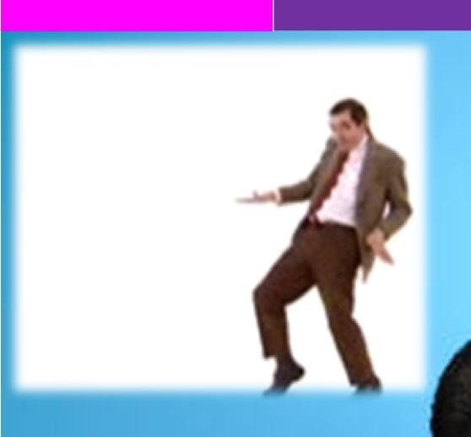

Finished!!!
You did it!!!

